Slide 1
EVENT-BASED DATA ASSURANCE
ALPHA PROJECT KICK OFF
27TH January 2020

Slide 2
Agenda
Introductions 12.00 – 12.15
Recap: why are we here? 12.15 – 14.00
Problem statements
Incoming hypotheses
Common Language / mental models
Perspectives: what matters to you? 14.00 – 14.50
Expressions of interest
Any open questions
Planning: what do we need to do next? 14.50 – 15.00
Resourcing for Workshops #1 and 2
Other?

Slide 3
Section 1
Recap: why are we here?

Slide 4
This OIX Alpha Project follows a discovery phase that was executed over the summer of 2019
Date | Milestone | Agenda
May 31st | Workshop 1 | Review proposed ecosystem definition and high level target functional architecture
June 21st | Workshop 2 | Use case examples from private, public and third sectors; use case for visualisation
July 4th | Workshop 3 | Finalise landscape review
August 1st | Workshop 4 | Review potential viable economic models
August 15th | Workshop 5 | Review use case visualisation
Project participants
DWP
Factern
HMRC
Idemia
Inidsol
Mydex
Santander
tScheme
Zonafide
https://openidentityexchange.org/blog/2019/11/14/building-a-trusted-environment-event-based-attribute-assurance/

Slide 5
Hypothesis: Events can be harnessed to improve data assurance outcomes
Events can be used as inputs into models that use different forms of reasoning to validate and verify claims, providing a powerful and agile defence against fraud
Relative to alternatives, Events are cheap to produce, publish, exchange and consume, and directly address the costs of duplicated effort
Events capture the individual micro-transactions which are aggregated to form competing quality standards, enabling overlaps to be identified and re-used
An Event-based approach federates trust to any entity with which we may have interacted, diversifying away from a reliance on a small number of sources
Events offer a mechanism for ‘thin file’ citizens or customers to provide third party evidence to support their claims, even in the absence of traditional forms of proof

Slide 6
Creating a Trusted Environment: basic framework
Layers:
Examples / Illustrations:
Solving for:
RC
RC
RC
RC
RC
RC
RC
…
Entities that are able to reason over the information received regardless of how it travelled across the layers
Resource Consumer
sovrin
Verify
TISA
eIDAS
[None]
Who are the participants of the ecosystem? What assurance standards are required? What is the commercial relationship?
Scheme
Exchange Infrastructure
Self-sovereign
Point-to-point
Aggregator / Hub
…
How are the messages transported between between ecosystem participants?
DISTRIBUTED CENTRALISED
What are the procedures for exchanging messages that communicate assurance between ecosystem participants?
Communication Protocols
DIDs
OIDC
SAML
IndieAuth
…
Verifiable Credentials
OIDF Identity Assurance
…
What is the broad format of the messages that communicate assurance between ecosystem participants?
Data model
Vocabulary, taxonomy and semantics relevant for data assurance (i.e. not limited to trust framework / use case), focused on:
Methods: approaches used to collate, verify or validate evidence
Events: granular activities aggregating to Method [e.g. under txn id]
What is the specific meaning of the different elements of a message that is used to communicate assurance between ecosystem participants?
Common Data Ontology
Semantic Web tools (e.g. RDF, OWL, SPARQL)*
What standards should be used to express and implement a shareable, extensible metadata model to support data assurance?
Implementation Standards
Good practice, expected behaviours, commercial norms
What is the basis on which participants who implement the metadata model can expect to interact with one another?
Rules of Engagement
* Proposal
Note: Schemes may support more than one exchange infrastructure type

Slide 7
Creating a Trusted Environment: problem statement
Schemes solve for a given use case. Participants mutually adopt commercial arrangements, infrastructure solutions, communication protocols and data models to create trust. The terms used to communicate assurance are context specific, and only as granular as each context requires.
The OIX Alpha Project aims to establish the requirements for an ecosystem in which Participants define fundamental units of data assurance as Events, and agree to make a record of the Events accessible through any arrangement that conforms to a basic set of rules of engagement.
Use Case 1
Use Case 2
Use Case 3
Use Case 1
Use Case 2
Use Case 3
…
Consumer
Consumer
Scheme
TISA
Scheme
Infrastructure
Point to Point
Infrastructure
Protocol
OIDC
Protocol
Data model
OIDF Identity Assurance
Data model
Ontology
?
?
Ontology
Standards
Standards
Rules
Rules
As a result, interoperability between different use cases that draw on the same End User claims is hindered by the lack of a common understanding of the fundamental basis on which those claims have been assured in each context.
Event Consumers (aka RPs) use Events to conduct their own risk assessment and map/aggregate them to the data assurance standard that is required in the specific context in which they are operating (e.g. as part of a scheme).
Note: Schemes may support more than one exchange infrastructure type

Slide 8
The objective of the Alpha Project is to develop an initial set of requirements to support the exchange of Event data
Default standards
Implement a shared knowledge base to describe Events and associated metadata
Lower barrier to entry for participation in an ecosystem for the exchange of Events
Enable interoperability across different technical implementations adopted
Initial ontology
Express occurrences that constitute ‘due diligence’ within the target use case
Generate a metadata model that establishes a common machine-readable understanding, as the basis for producing, exchanging or consuming Events
Rules of engagement
Govern behaviour within the ecosystem
Avoid any unnecessary barriers to entry into the ecosystem
Explore ways of simplifying the exchange of value associated with the exchange of data, enabling a scalable contractual framework

Slide 9
What do we mean by “Data Assurance”?
Investigating the nature of a claim
Valid;
Genuine
has status
Controlling entity
Issuer
Evidence
Claimant
A
trusts
B
issues
C
has subject
D
contains
claims to hold
Attribute
is same as
Attribute

Slide 10
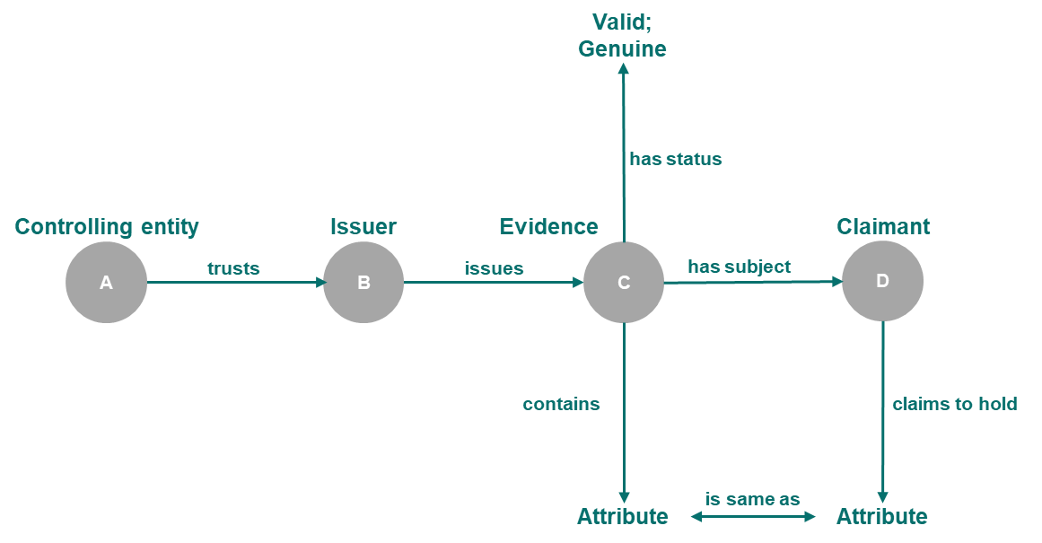
What do we mean by “Data Assurance”?
Assigning a status to a claim
“Controlling Entity A says that Claimant D holds [Attribute], to confidence level [X]”
Based on…

Slide 11
What do we mean by an “Event”?
We define an “Event” as a trustable record of any attribute, relationship or activity that is made available as a digital resource for re-use by authorised third parties.
Trustable:
An Event is a signed witness statement of the form: “X says that Y is true” ¹
Understandable:
Events reference attributes, relationships or activities whose meaning has been defined – and can be shared – in a standard, relatable, machine-readable way ²
Accessible:
An Event can be consumed directly (at scale) by automated reasoning engines
An Event is explicitly made available for re-use by authorised third parties
Access to an Event is governed separately to access to the data (i.e. attributes, relationships or activities) that the Event references
1. This is similar in form to a Verifiable Credential 2. Leveraging tools from the Semantic Web

Slide 12
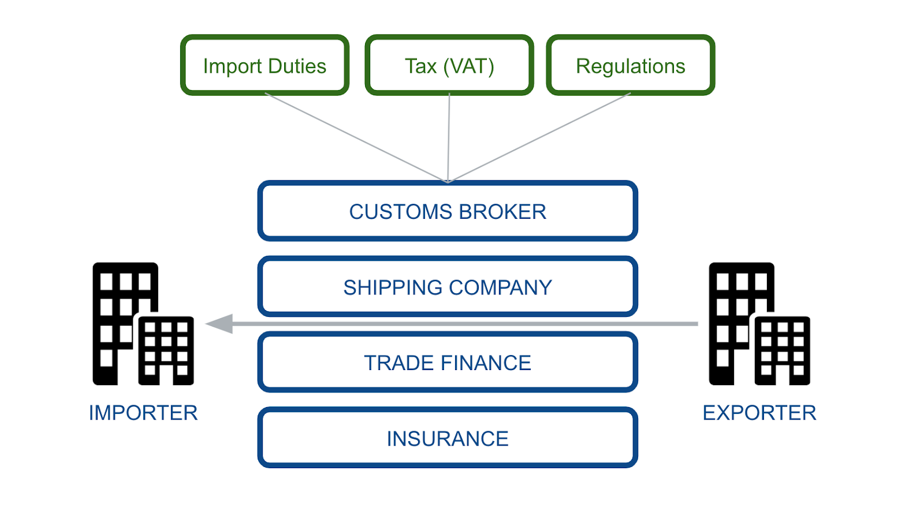
Target use case: inspection of wine being imported into the UK
The target use case focuses on goods (e.g. wine) being imported into the UK
Extensive descriptive information is captured (e.g. V1 form) and shared across different platforms
27+ UK government agencies who may have an interest in the goods being imported
Each agency makes a risk-based decision whether to conduct its own inspection of the goods
Authorised exchange of event data (e.g. prior inspections) can be used to support this decision

Slide 13
Section 2
Perspectives: what matters to you?

Slide 14
Expressions of interest? Open questions?
What is this thing we are defining and building called?
How to sell it to non technical senior stakeholders?
What is the business case for the different parties involved?
How do government agencies currently access information (paper?)
How do government agencies current assess risk (or do they?)
How will ‘event data’ be consumed and made available by (existing) applications?
What systems are required by (one or more) government agencies?
Will ‘on the ground’ business processes need to change?

Slide 15
Section 3
Planning: what do we need to do next?

Slide 16
Workshop schedule and agenda
W/s | Date | Deliverable | Agenda | Attendees
KO | 29/01 1-4pm | Common understanding | Questions Problem statements Expressions of interest | FB Technical Architect HMRC Technical Architect HMRC Innovation Lead
#1 | 05/02 1-4pm | Standards | Standards to implement and communicate shared knowledge base used in event-based data assurance
#2 | 12/02 1-4pm | Metadata model | Reasoning models for data assurance Classification Events Chains / sequences / methods Actors (e.g. source of events) Relationships (e.g. linking IDs) Supporting metadata Schema / headers Mandatory Optional
#3 | 19/02 1-4pm
#4 | 26/02 1-4pm
#5 | 04/03 1-4pm | Security | Security assessment of proposed standards and metadata model | NCSC representative
#6 | 11/03 1-4pm | Rules of engagement | Boundary of open alliance Scalable / mutual contractual agreements for value exchange Value exchange mechanisms Publication of / subscription to events Permissioning (including consent) Use of standards and metadata model Governance | HMRC Innovation Lead HMRC Stakeholders x2 GDS representative(s)
#7 | 18/03 1-4pm
#8 | 25/03 9am-12

Slide 17
Appendix
Supporting slides

Slide 18
What do we mean by an “Event”?
“Claimant A says that Claimant A is employed by Entity XYZ”
is not the same as:
“Witness B says that Claimant A is employed by Entity XYZ”
is not the same as:
“Entity XYZ says that Claimant A is employed by Entity XYZ”
3
separate events

Slide 19
What do we mean by an “Event”?
“Controlling Entity A says that Claimant D holds [Attribute]”
Based on…
3
separate events
Controlling Entity A says that…
Based on…
“Bob in the branch says that he had a quick look”

Slide 20
What do we mean by a “Trusted Environment”?
Relative roles within the ecosystem
Entity A
Entity B
Entity A/C
Event Producer
User
Claimant
Event Consumer
Rules of engagement

Slide 21
Is there a viable economic model for the exchange of Events?
Motivation for each role
Entity A
Entity B
Entity A/C
Event Producer
User
Claimant
Event Consumer
Reduce cost
Recover cost
Broaden service offer
Convenience
Confidence
Continuity
Avoid cost
Manage risk
Improve experience

Slide 22
Is there a viable economic model for the exchange of Events?
Value exchange across the ecosystem
Entity A
Entity B
Entity A/C
Event Producer
User
Claimant
2. Request access to Event
Event Consumer
1. Give User (some level of) control over the disclosure of Events
3. Authorise access to Event
4. Make access to Event contingent on commercial terms
and/or
5. Make accountability for accuracy of attribute/assertion/activity contingent on commercial terms
6. Acceptance of commercial terms

Slide 23
What infrastructure needs to be in place?
Rules of engagement
Vocabulary and semantics
Discovery
Transport and trust
Contracting, accounting and settlement

Slide 24
What implementation options are there?
Example implementation options
Event Producer
Publish
Event Consumer
User
Claimant
Aggregator
Event Producer
Query
Permission
Publish
Event Producer
Publish
Event Producer
Event Consumer
User
Claimant
Point-to-point
Query
Permission
Event Producer
User
Claimant
Event Consumer
Self-sovereign
Publish
Publish
Trust Framework

